Slide 1
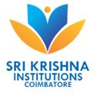

SRI KRISHNA COLLEGE OF ENGINEERING AND TECHNOLOGY (AN AUTONOMOUS INSTITUTION | AFFILIATED TO ANNA UNIVERSITY | ACCREDITED BY NAAC WITH “A” GRADE) ACCREDITED BY NBA(CSE, IT, ECE, EEE, MECH, MCT & CIVIL) KUNIAMUTHUR, COIMBATORE, TAMILNADU, INDIA
SKCET STUDY MATERIAL
Subject Name : PHYSICS - 23PHI101
Module : I – WAVE OPTICS
TOPIC : INTRODUCTION TO SEMICONDUCTOR
BRANCH : I M.TECH.CSE
Dr. I. Pradeep
Associate Professors in Physics
Department of Science and Humanities

Slide 2
Semiconducting Materials
INTRODUCTION
A semiconductor has electrical conductivity between that of a conductor and an insulator.
Semiconductors differ from metals in their characteristic property of decreasing electrical resistivity with increasing temperature.
Semiconductors can also display properties of passing current more easily in one direction than the other, and sensitivity to light.

Slide 3
Because the conductive properties of a semiconductor can be modified by controlled addition of impurities or by the application of electrical fields or light.
Semiconductors are very useful devices for amplification of signals, switching, and energy conversion.
The comprehensive theory of semiconductors relies on the principles of quantum physics to explain the motions of electrons through a lattice of atoms.

Slide 4
Current conduction in a semiconductor occurs via free electrons and holes, collectively known as charge carriers.
Adding a small amount of impurity atoms greatly increases the number of charge carriers within it.
When a doped semiconductor contains excess holes it is called “p-type,” and when it contains excess free electrons it is known as “n-type”.

Slide 5
The semiconductor material used in devices is doped under highly controlled conditions to precisely control the location and concentration of p- and n-type dopants.
A single semiconductor crystal can have multiple p and n type regions; the p-n junctions between these regions have many useful electronic properties.

Slide 6
Semiconductors are the foundation of modern electronics, including radio, computers, and telephones.
Semiconductor-based electronic components include transistors, solar cells, many kinds of diodes including the light-emitting diode (LED), the silicon controlled rectifier, photo-diodes, digital analog integrated circuits.

Slide 7
Increasing understanding of semiconductor materials and fabrication processes has made possible continuing increases in the complexity and speed of semiconductor devices, an effect known as Moore’s Law.
“The number of transistors incorporated in a chip will approximately double every 24 months.” known as Moore’s Law.

Slide 8
Properties of semiconductor
The resistivity of semiconductors lies between a conductor and an Insulator.
(It various from 10^{–4} to 0.5 Ωm).
At 0 K it behave as insulator.
They have negative temperature Coefficient of resistance. When the temperature is increased large number of charge carriers are produced due to breaking of covalent bonds and hence these electrons move freely and gives rise to conductivity)
In semiconductors, both electrons and holes are charge carriers.

Slide 9

If we increase the temperature of semiconductor, its electrical conductivity also increases.
They have an empty conduction band and almost filled valence band 0 K.
They are formed by a covalent bonds.
They have small energy gap (or) band gap.

Slide 10
CLASSIFICATION OF SEMICONDUCTORS
Based on the purity, semiconductor is classified into two types.
1. Intrinsic semiconductors or Elemental semiconductors
2. Extrinsic semiconductors or Compound semiconductors

Slide 11
Intrinsic semiconductors
A pure semiconductor without any impurities is known as an intrinsic semiconductor.
Example: Ge, Si (In the form of pure)
These are made from single element. They also known as indirect band gap semiconductors.

Slide 12
In which the recombination of free electron from the conduction band with the hole in the valence band takes place via traps.
During recombination phonons [lattice vibrations] are produced and they heat the crystal lattice (position of the atom). These are the IV group element in the periodic table.

Slide 13
Compound Semiconductors
The Compound Semiconductor is a semiconductor compound composed of elements from two or more different groups of the periodic table.
They also known as direct band gap semiconductors.
i.e., III – V group, II – VI group and IV – VI group.

Slide 14
Here the recombination electron and hole takes place directly, during recombination photons are emitted.
Example : GaAs, GaP,
Based on the type of impurity they are classified into
i) N-type semiconductor
ii) P-type semiconductor

Slide 15
Difference between N-type and P-type semiconductor
N-type
P-type
It is donor type
Impurity atom is pentavalent
Donor level lies close to the bottom of the conduction band
It is acceptor type
Impurity atom is trivalent
Acceptor level lies close to the top of the valence band.

Slide 16
Difference between Elemental and Compound Semiconductors
Elemental semiconductors
Compound semiconductors
These are made from single element.(mixed) element.
These are made from IV group and VI group elements.
These are called as indirect band gap semiconductor (electron-hole recombination takes place through traps)
These are made from compound.
These are made from III and V [or] II and VI elements.
These are called as direct band gap
semiconductor (electron-hole recombination takes place directly)

Slide 17
Heat is produced in the recombination.
Life time of charge carriers is more due to indirect recombination.
Current amplification is more.
These are used for making diodes, transistor, etc.
Example : Ge, Si
Photons are emitted during recombination.
Life time of charge carriers is less due to direct recombination.
Current amplification is less.
These are used for making LED, laser diodes, etc.
Example : GaAs, GaP, CdS, MgO

Slide 18
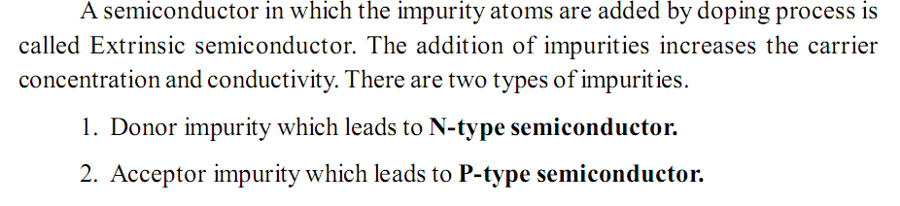
EXTRINSIC SEMICONDUCTOR

Slide 19
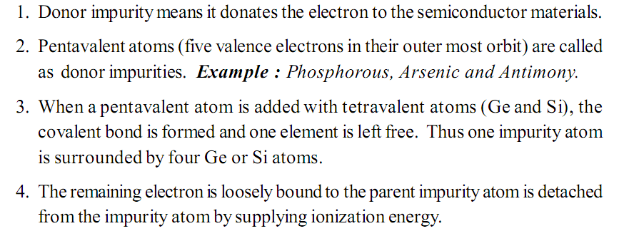
N-type Semiconductor (Donor impurity)

Slide 20
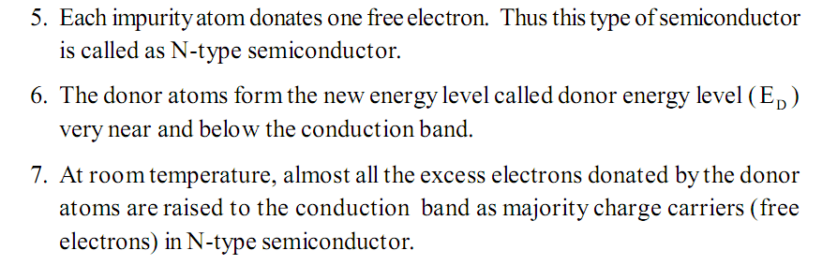

Slide 21
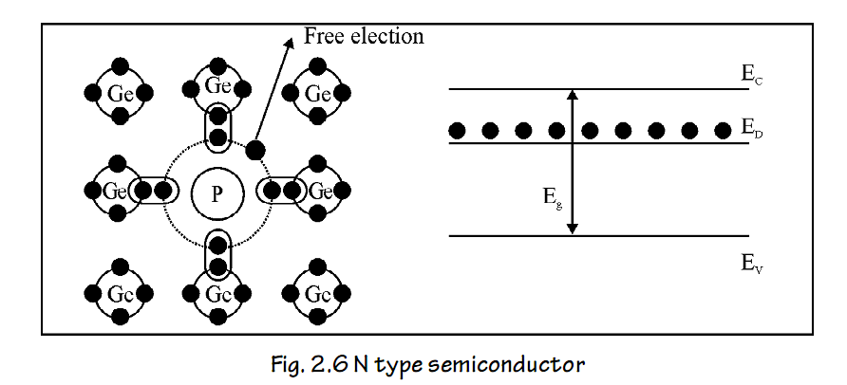

Slide 22
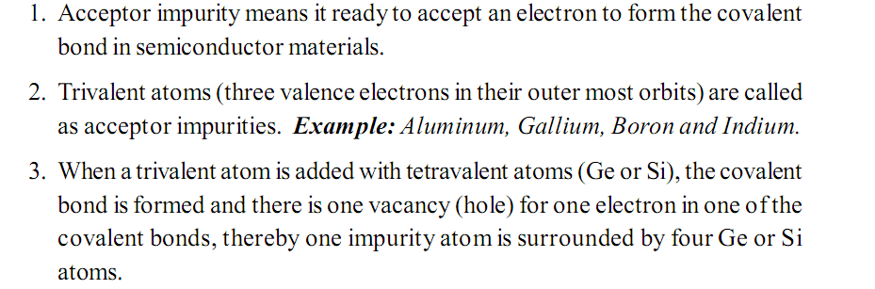
P – type Semiconductor (Acceptor Impurities)

Slide 23
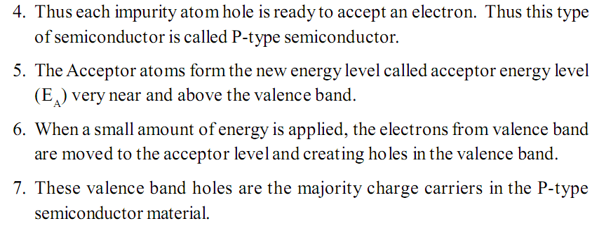

Slide 24
